Slide 1

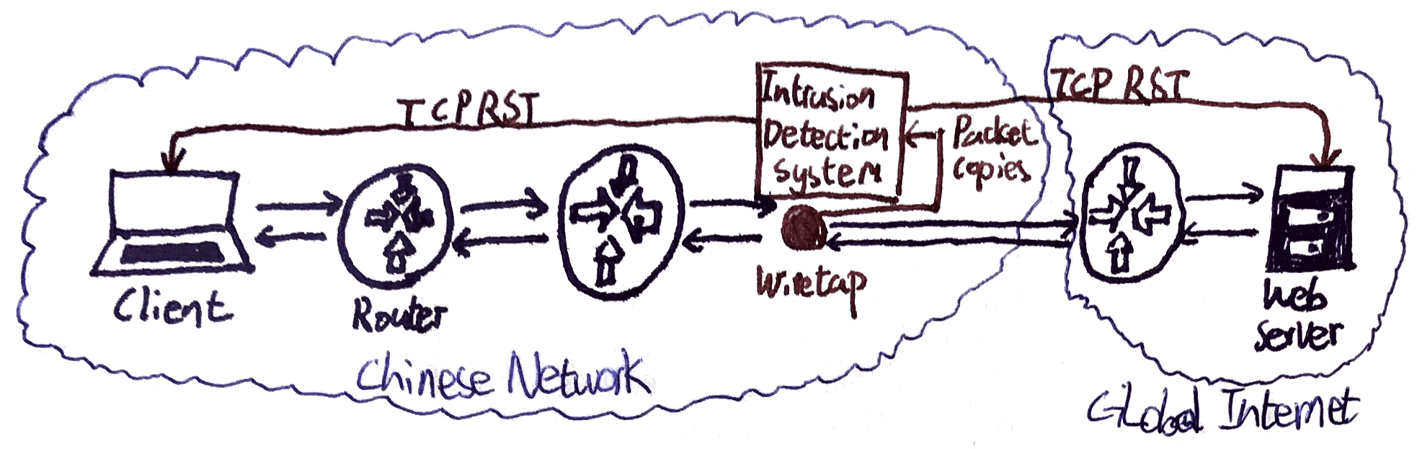
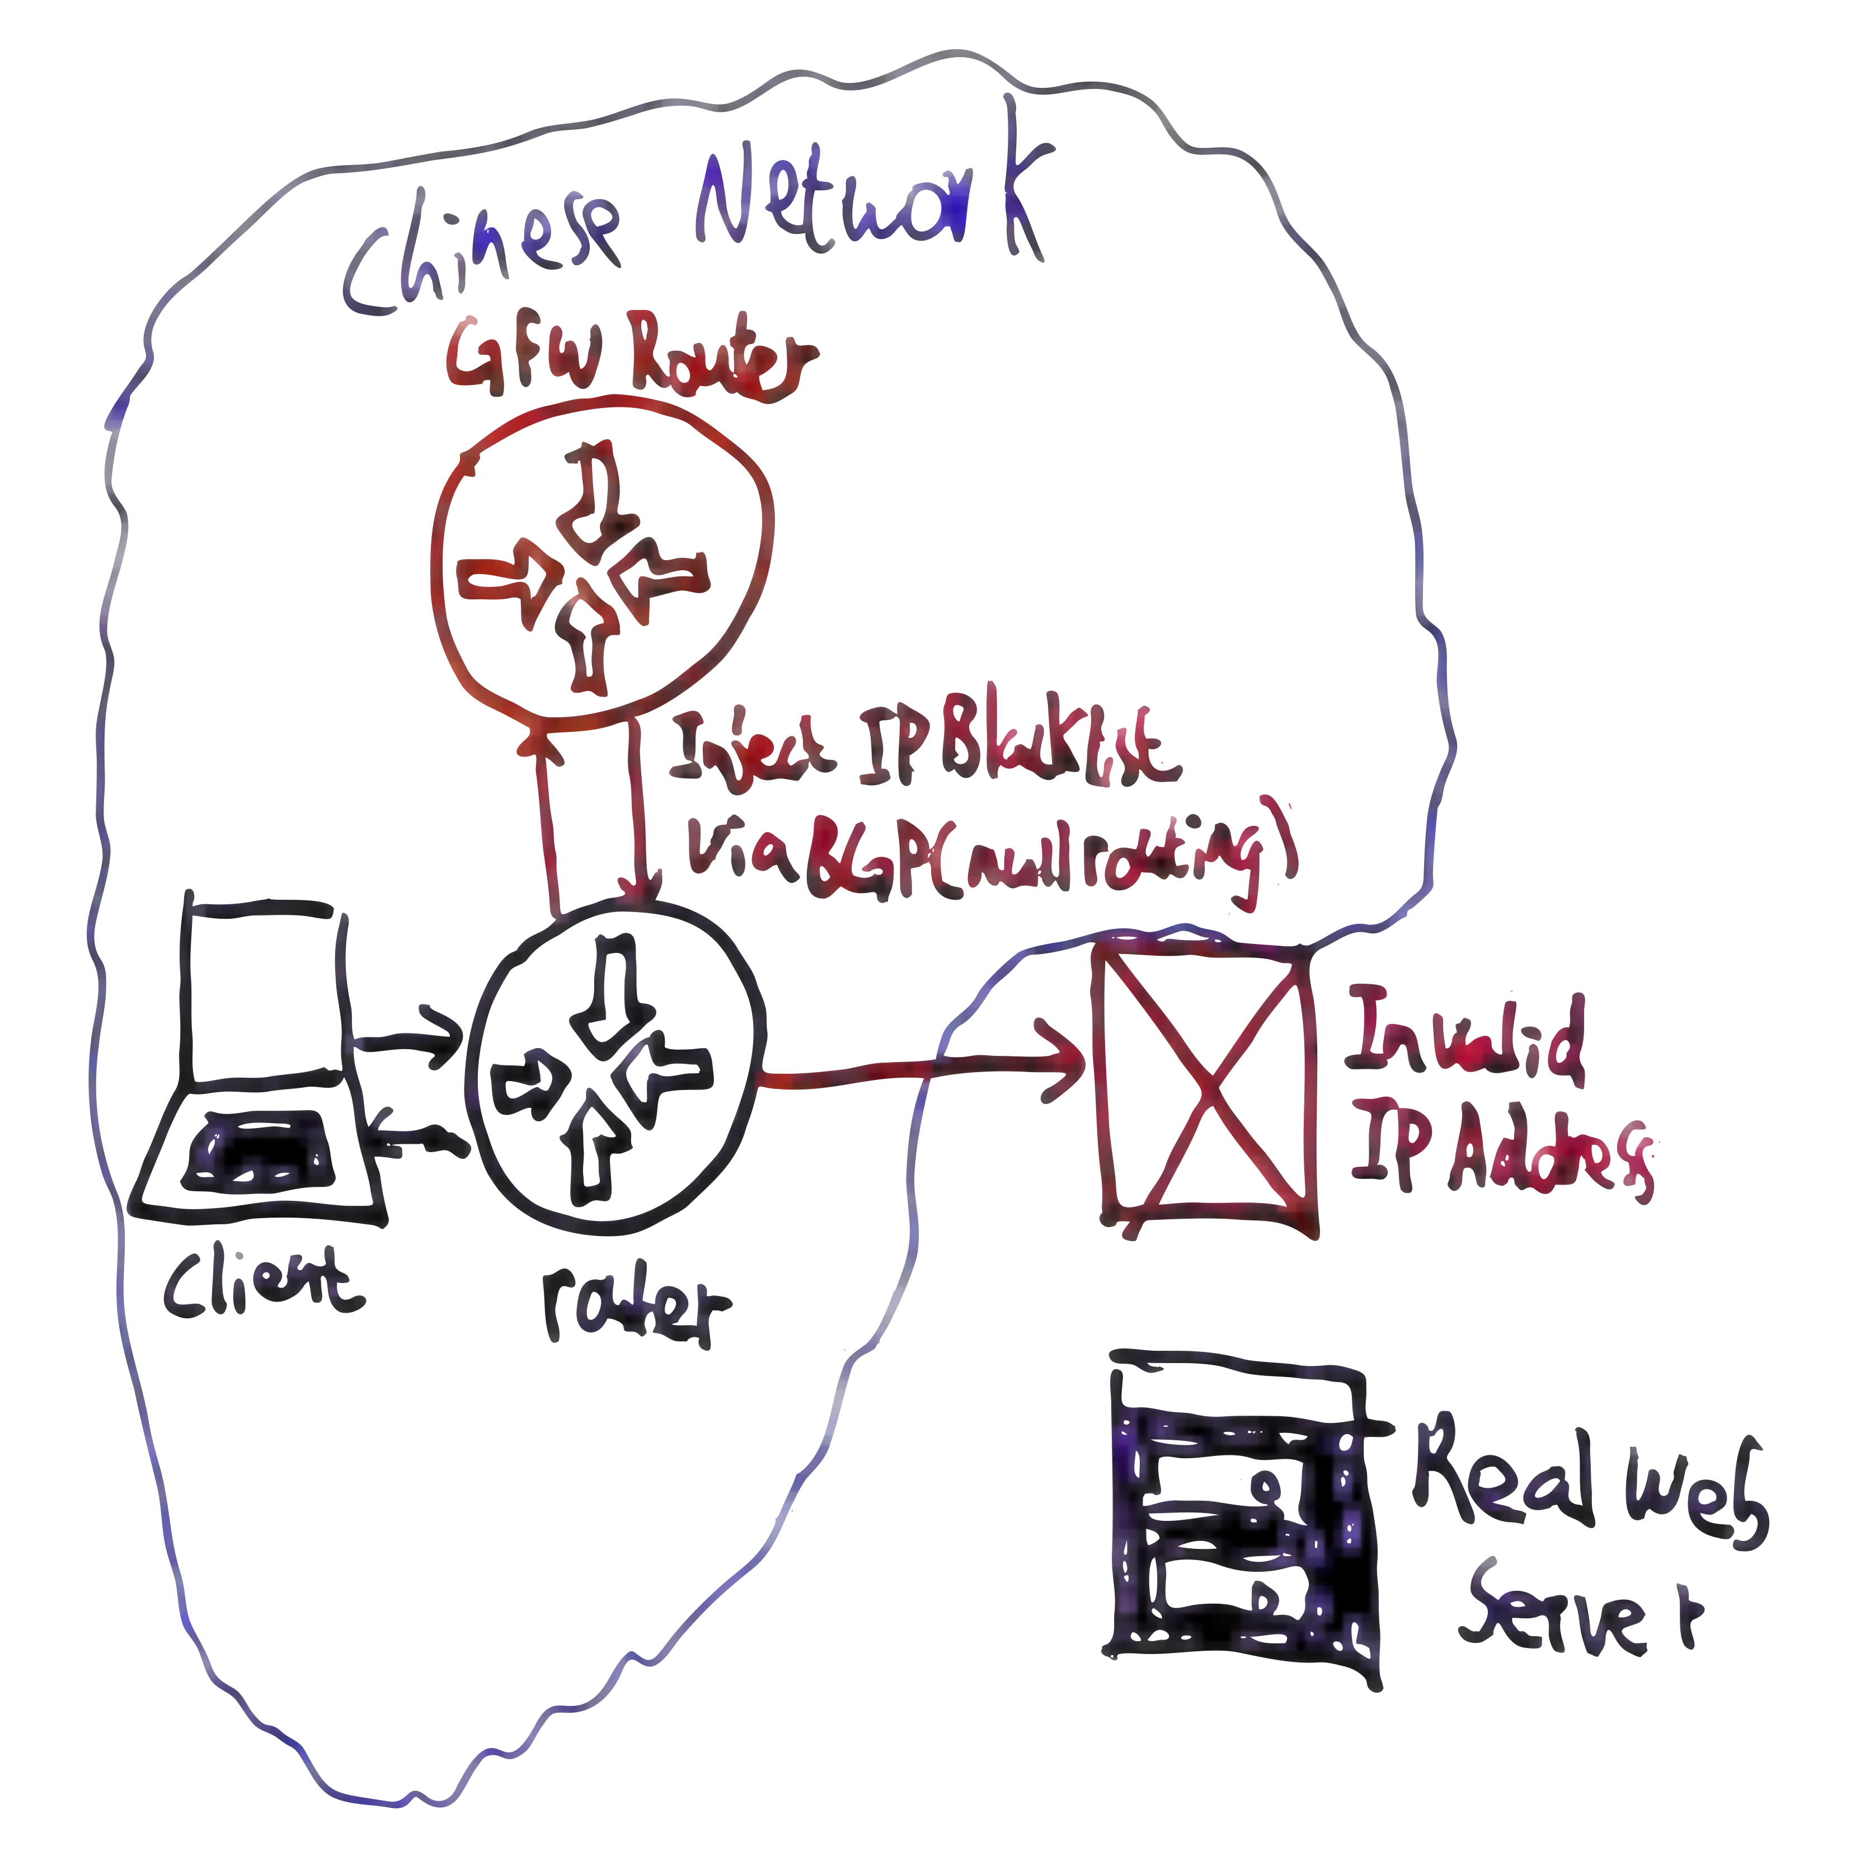
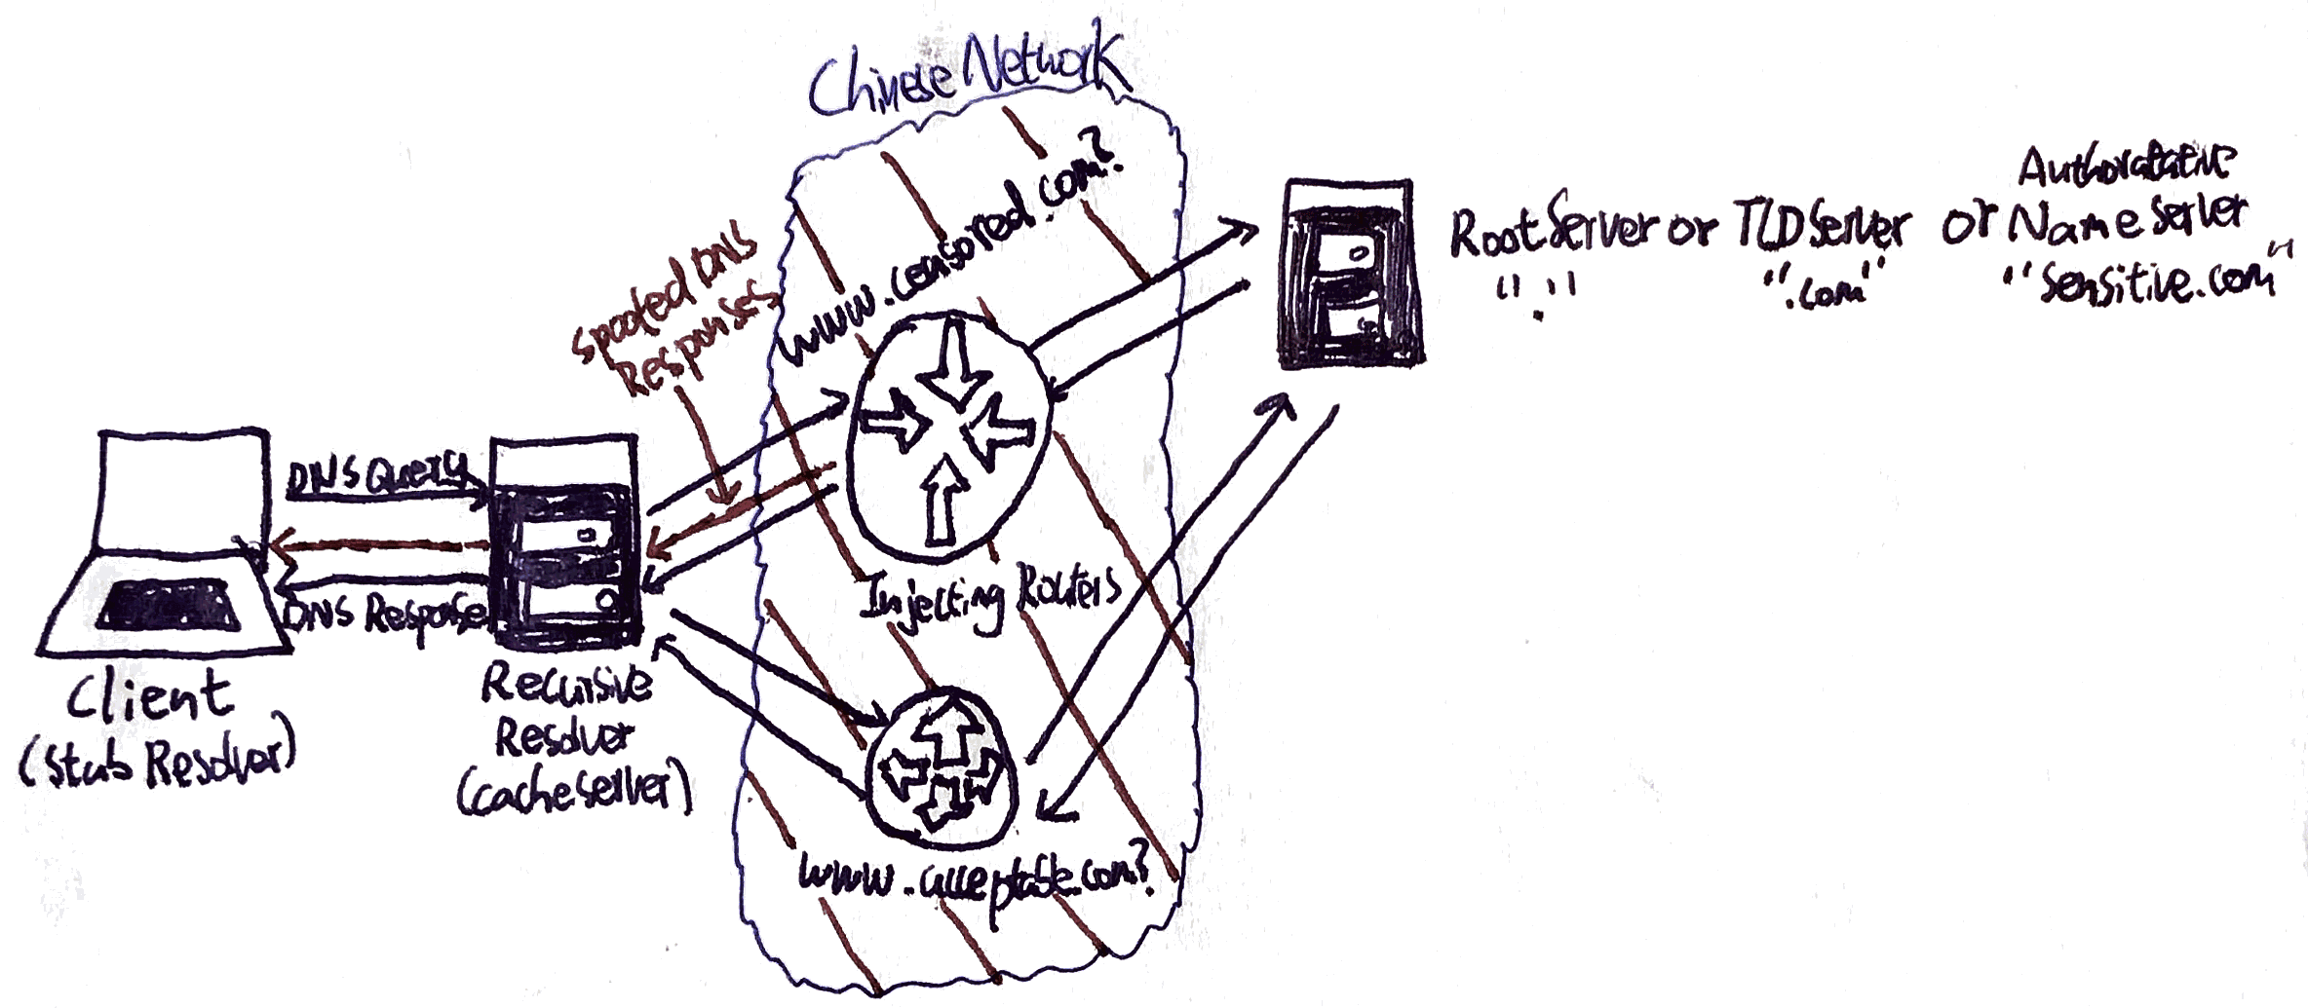
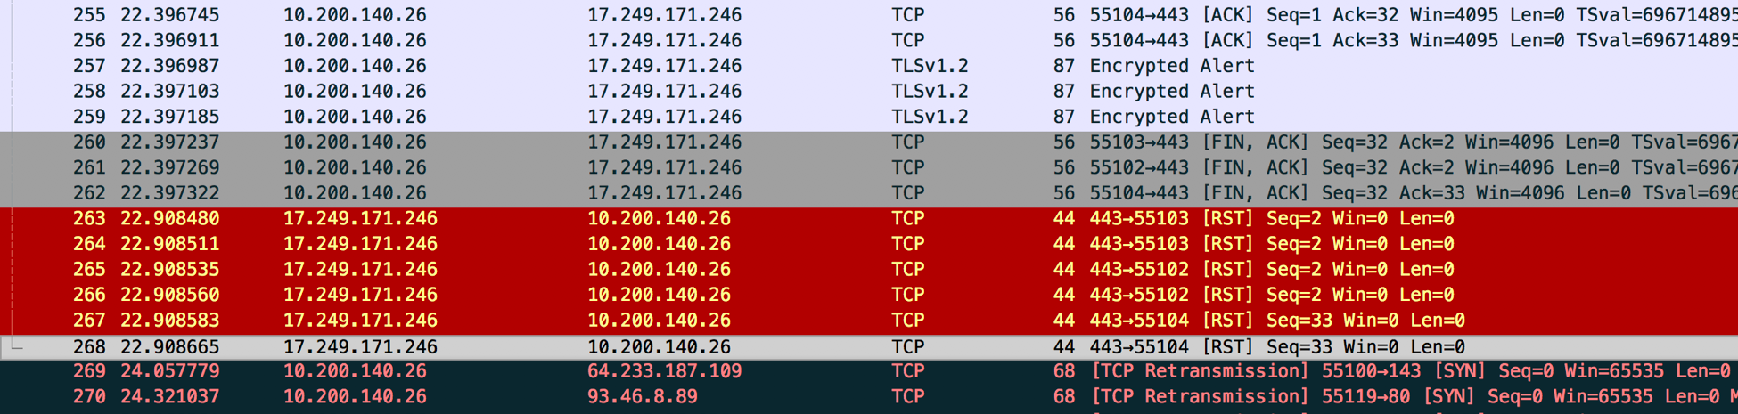
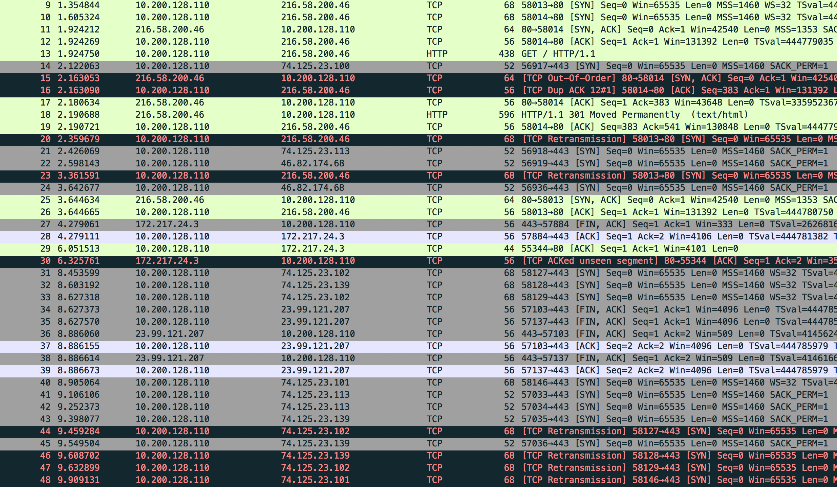
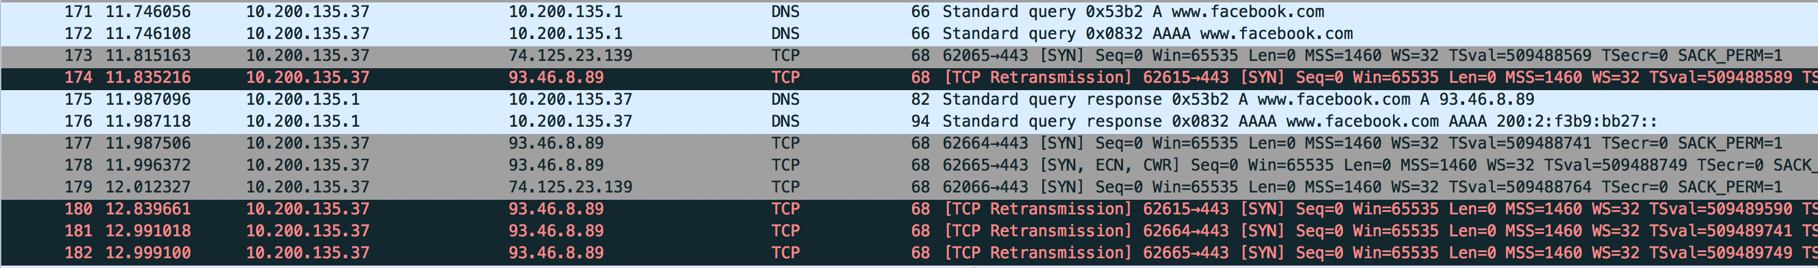
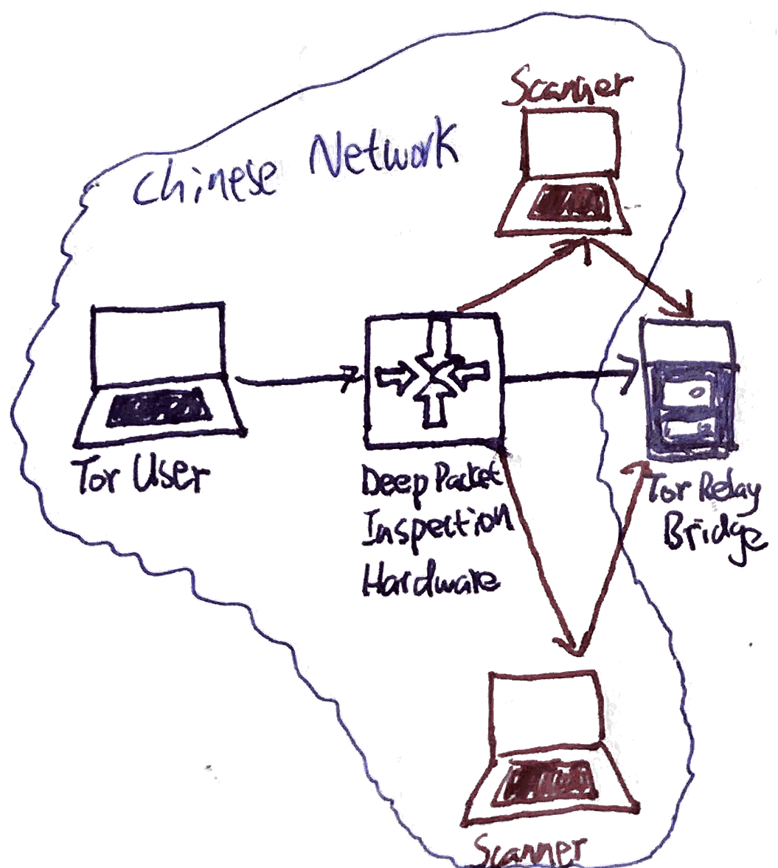
In-depth analysis of the Great Firewall of China
Chao Tang, COMP 116, December 14, 2016
Abstract
Created by the Golden Shield Project, the Great Firewall of China (GFW) is the backbone of world’s largest system of censorship. As an on-path system, the GFW can monitor traffic and inject additional packets, but cannot stop in-flight packets from reaching its destination. It achieves censorship using three main techniques: First, it inspects all Internet traffic between China and the rest of the world, then terminate connections containing censored content by injecting forged TCP Reset packets to both ends. With the advent of HTTPS, which cannot be decrypted by the GFW, TCP RST has seen fewer use in recent years. Second, the GFW blocks access to specific IP addresses through the gateway routers of all Chinese ISPs. Third, it uses DNS tampering to return false IP addresses in response to DNS queries to blocked domains. This affects queries to both domestic and foreign DNS services. IP blocking and DNS tampering together are the bread and butter of GFW, effectively cutting off all access to blocked websites. But, such draconian methods inevitably cause over-censoring and collateral damage to international web traffic flowing through China and innocent websites. The three main ways a user can bypass the GFW are the use of VPNs, Proxies, and Tor. However, GFW can use deep packet inspection and machine learning to shutdown suspected VPN or proxy tunnels, and use an active probing system to shutdown Tor bridge relays. As of today, few commercial VPN services and the latest Tor protocols using Pluggable Transports are viable approaches.
TCP Reset
IP Address Blocking
DNS Tampering
How It works
The GFW inspects traffic by passing copies to out-of-band devices based on Intrusion Detection Systems. The original packets are unaffected, while the IDS inspects the content of the packet and the requested URL. Once the IDS detects blacklisted keywords, the GFW router injects multiple forged TCP RST packets to both endpoints, forcing the connection to be dropped.
How It works
By peering with the gateway routers of all Chinese ISPs, GFW injects a list of blacklisted destination addresses into BGP (Border Gateway Protocol) and hijacks all traffic to blocked websites. This technique is called null routing.
How It works
GFW monitors each DNS query originating from any clients inside China at the border of the Chinese Internet. If it detects a query to a blocked domain name, it injects a fake DNS reply with an invalid IP. This fake DNS reply then trickles down to internal recursive DNS servers in China. Thus, almost all DNS resolvers in China have poisoned caches.
Pros
- On-path architecture is efficient and does not create a bottleneck
- Capable of IP and TCP segments reassembly
- Maintains flow state regarding source and destination to block all further communications for any period of time.
Cons
Not capable of inspecting HTTPS traffic
Can be bypassed by ignoring RST packets on both endpoints
Due to these constraints, TCP RST is now rarely used
Pros
Only adds a small load to the gateway router
No additional infrastructure needed
Centralized blacklist without further involvement from ISPs
Cons
Blacklist needs to be frequently updated
Websites can change IP addresses to stay unblocked
Over-censoring of legitimate websites that share the same IP addresses or address blocks as blocked websites
Pros
Lightweight yet efficient
There is little a blocked website can do besides changing domain name
Effectively seal off all access when used in conjunction with IP address blocking
Cons
Large-scale collateral damage to DNS queries passing through China originating elsewhere
Can unintentionally redirect huge volumes of traffic to innocent websites
Failed Attempt
While connected to a VPN server in Shenzhen, the author used Yahoo to search for the censored string “falun”. The author was unable to connect to websites from the results page, evident by TCP Retransmissions. The author initially thought the five TCP RST packets were the doings of GFW. However, the ACK number of the packets were all 0, which is uncharacteristic of forged TCP RST packets. Thus, it is unlikely that GFW was at play here.
Successful Attempt
While connected to a VPN server in Shenzhen, the author tried to access Google via the IP 216.58.200.46. No data was received and the site eventually timed out, as evident by the TCP Retransmission packets in black.
Successful Attempt
While connected to a VPN server in Shenzhen, the author tried to access www.facebook.com, as can be seen from the standard query. DNS server returned a poisoned address, 93.46.8.89. The TCP retransmissions is evidence the IP is invalid. Further research revealed that this is one of seven poisoned IPs regularly used by the GFW .
Using VPNs and Proxies
Bypassing the Great Firewall
Using Tor
How they work
Virtual Private Networks work by routing all traffic to and from a computer through a server using many secure protocols. Thus, all connections to the outside web appear to be coming from the location of the VPN server instead of the user’s actual location. Proxies function similarly, except only browser traffic is encrypted.
Countermeasures by GFW
The GFW has enough understanding of popular VPN protocols such that it can use deep packet inspection and machine learning to identify VPN connections. It finds heuristics to guess which TCP/UDP connections are used for VPN, then simply drops all packets.
Answers to countermeasures
For non-commercial VPN setups, the only way to manually disguise VPN traffic is to make it look like standard HTTPS sessions. There are many details that need to be manually matched. A few commercial VPNs also operate in China, despite the fact that they can be easily shutdown by the government at any time.
How it works
Tor's users employ the Tor network by connecting through a series of virtual tunnels rather than making a direct connection, allowing them to circumvent the GFW.
Countermeasures by GFW
Tor relies on a large number of entry guards and bridge relays as end points to offer connections to censored regions. The GFW implemented a real-time probing system that searches for bytes that identify a network connection as Tor. If these bytes are found, the firewall initiates a scan of the host which is believed to be a bridge and shuts it down. This rendered Tor completely inaccessible in China for 3 years.
Answers to countermeasures
In 2015, the Tor project released obfs4 and Meek, two protocols that use Pluggable Transports. Pluggable Transports transform the Tor traffic between client and bridge. Obfs4 offers an extra layer of encryption using a shared secret key distributed out-of-band, while Meek disguises Tor traffic as regular cloud computing traffic. Both are currently viable options.

